Slide 1


PRUDENTIAL LIFE
INSURANCE ASSESSMENT
---- Superfluous MODEL
Chenyu Xu Zhaoning Qi
Kesen Zhang Xiabing Hu
Notes:
Good morning everyone, thank you for making the efforts to come today. My name is Emily. These are my teammates: Erin, Mercury and Jeff and we are students of Professor Miquel. Today we gonna introduce a model named ‘Superfluous’ model that is designed by us. I know some of you guys might feel confused why we name the model ‘Superfluous’, just keeping listening and at the end of this presentation, you gonna realize why.

Slide 2
Content
Business Problem
Data Preparation and Exploration
Modeling
Interpretation of Results
Improvement
Business Impact
Notes:
In order to help everyone understand it comprehensively, we will explain it through six aspects:
First, we will clarify what is the business problem and why we wanna design this model.
Then, we will talk about how did we prepare and explore the data set.
In the third section, we will explain our model in detail, followed by the interpretation of results.
Finally, in the last two parts, we will discuss about how we could improve our model in the future and how our model gonna affect the business.
Now, let’s move on to the first part.

Slide 3
1.BUSINESS PROBLEM
Kesen Zhang (Emily)
Notes:
The Business Problem

Slide 4
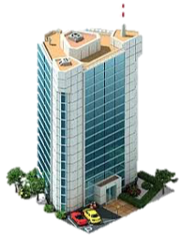


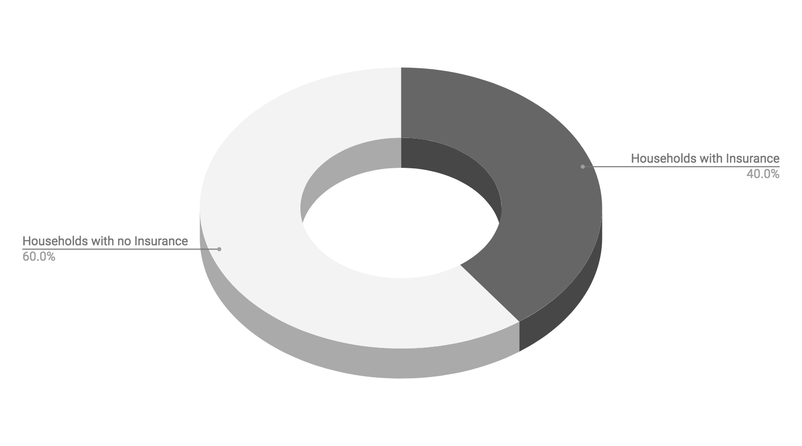
Business Problem
In the US, only 40% households have individual life insurance. This problem is mainly caused by the complex application process.
Notes:
First, before I start, I would like to ask you guys some questions:
How many people here have bought life insurance before? Please raise your hands.
And how many of you think it is complex to buy insurance? Thank you very much!
Actually, In the US, only 40% households have individual life insurance. This problem is mainly caused by the complex application process.
For instance, if a person wants to buy an insurance, in addition to choosing the right insurance company and package, he must also take a medical examination held by a third-party agency which costs 30 days in average. The complicated and long process gave up many interested customers. This situation has a very large negative impact on both insurance companies and consumers. Insurance companies can not attract enough customers, and consumers can not get protection for themselves and their families.
Therefore, we want to build a model to help insurance companies manage risk and pricing more reasonable.Based on customer’s information, assessing customer’s level.

Slide 5
2.DATA PREPARATION
AND EXPLORATION
Kesen Zhang (Emily)
Notes:
Now, let’s focus on how we did the data preprocessing.

Slide 6
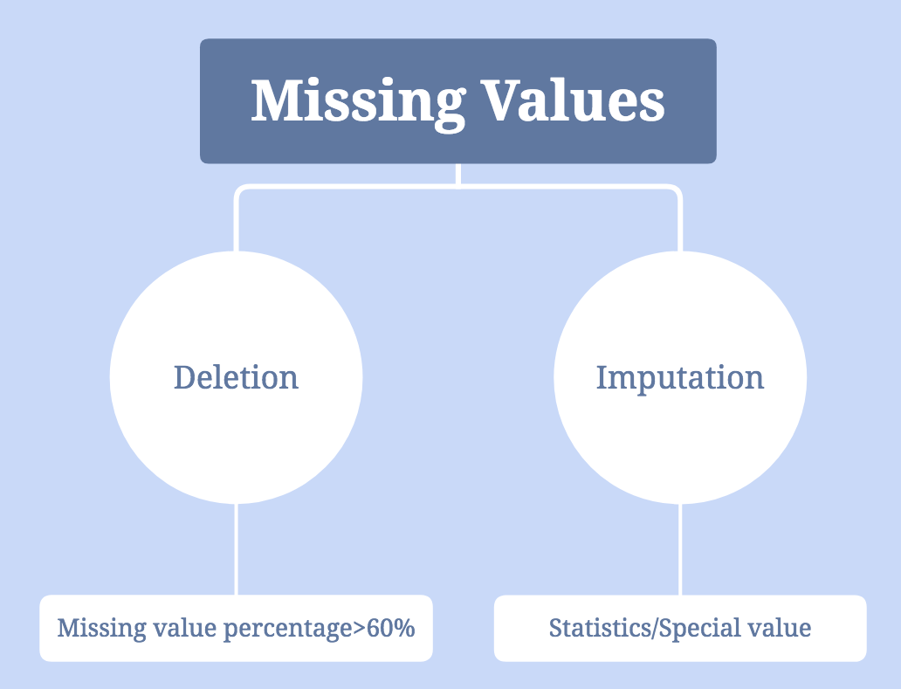
Data Cleaning
Notes:
First, 对缺失值 我们有两种方式 删和补
For the rest of continuous data, we put the mean value into the blank and put the median value into blank of discrete data. Besides, for XGBoost, we use a extreme value (such as -10000) to fill the blank due to its unique feature.

Slide 7
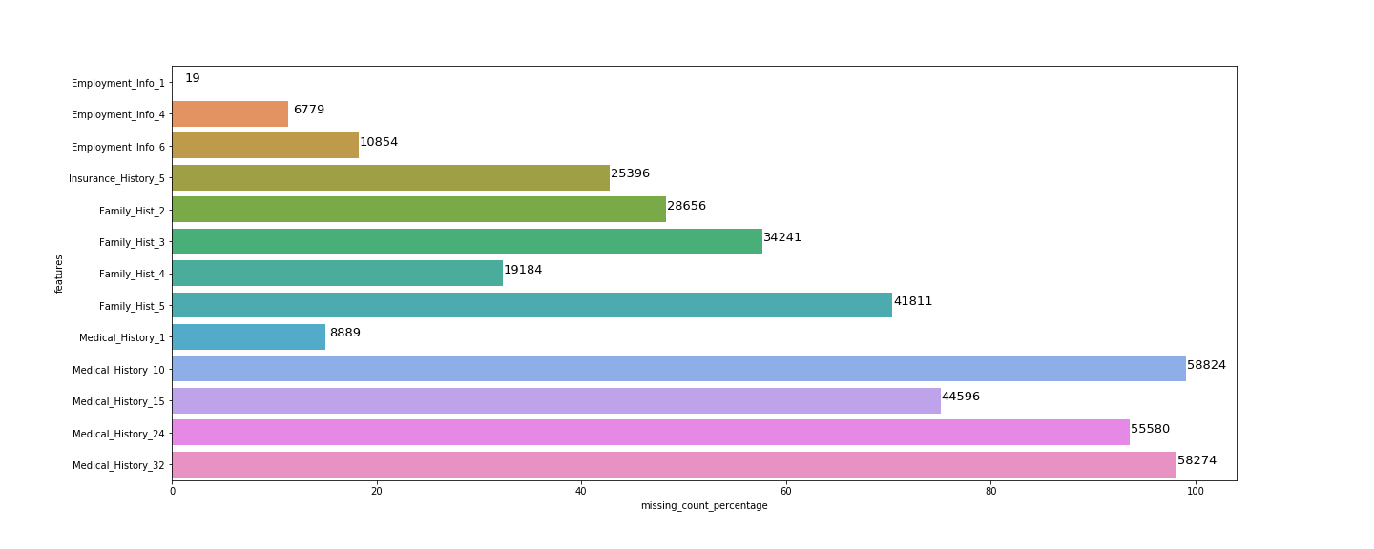
Missing Value Deletion
Notes:
我们打算缺失60%以上的数据 delete了 以免fill na对模型产生很大的影响
Firstly, we decided to delete features with a missing rate of more than 60%. Therefore, according to the figure above, we deleted following features: Id, Medical_History_32, Medical_History_24, Medical_History_15, Medical_History_10 and Family_Hist_5.

Slide 8
Data Cleaning
Notes:
对缺失值 我们有两种方式 删和补
For the rest of continuous data, we put the mean value into the blank and put the median value into blank of discrete data. Besides, for XGBoost, we use a extreme value (such as -10000) to fill the blank due to its unique feature.

Slide 9
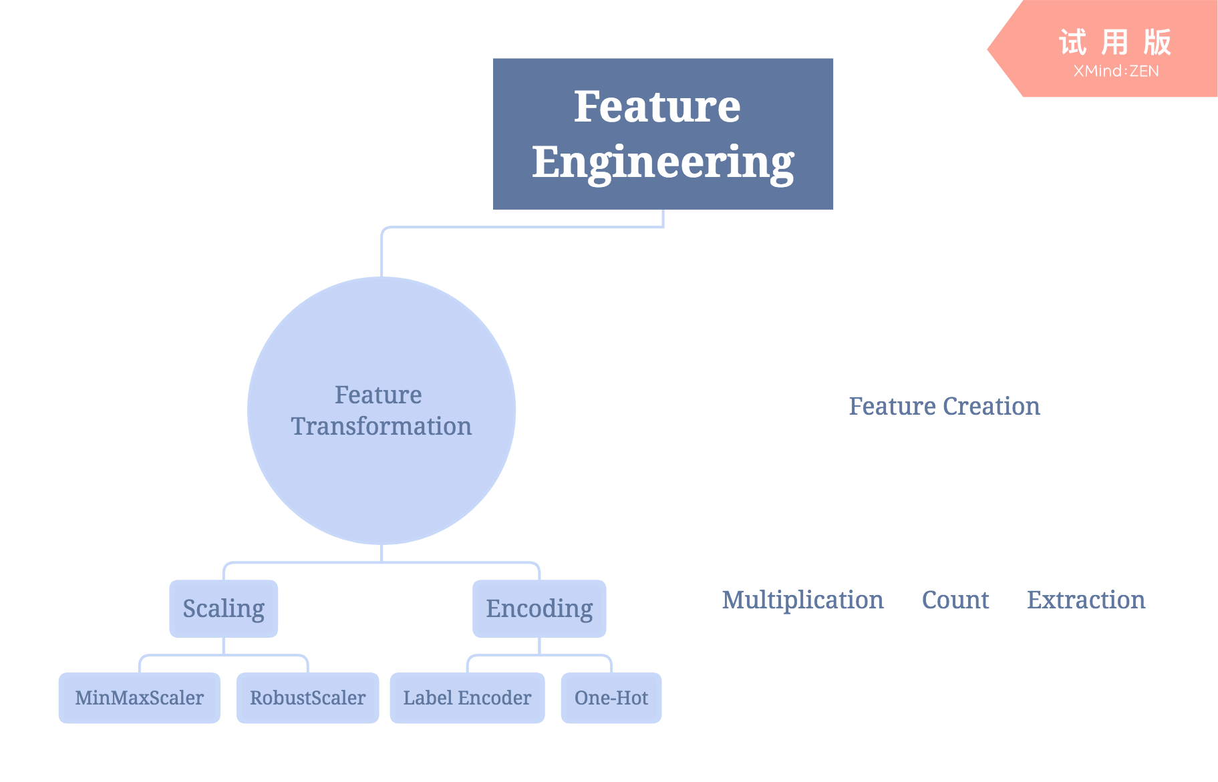
Notes:
在特征工程中 有两种对特征的处理方式
Label encoder 把target feature（float型）transfer into int
本来打算用onehot 处理categorical features 但是实践发现 one hot之后的特征会变得十分稀疏 scatter sparse 各个特征的重要性 相关度都不高了 所以没什么效果 没用
Bmi— count 影响都是一个方向 指的是某种病的换与否 加起来就是 患病量！

Slide 10
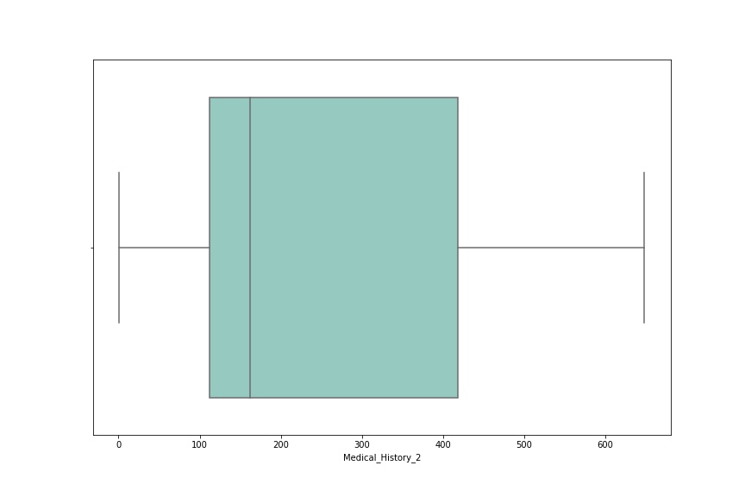
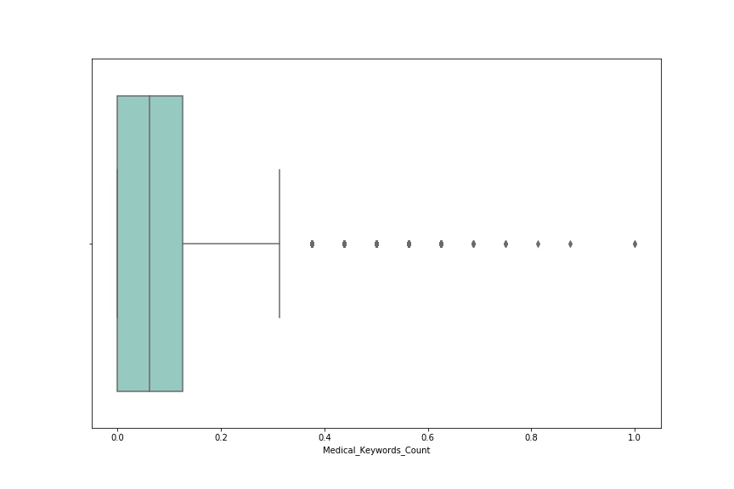
Scaling features to range -- MinMaxScaler
Notes:
从图上可以看到 数据集中在一个整数范围内
但是从数量大小来看 ta可能是类似就医次数的特征
不属于category features
所以我们用minmax scaler to scale the features to range

Slide 11
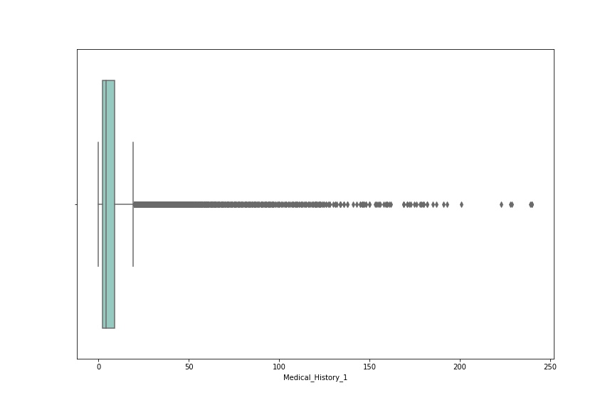
Scaling data with outliers -- RobustScaler
Notes:
As can be seen from the figure, the Outliers of this set of data are much wider, so it would be a better choice for us to use RobustScaler to make the data more descriptive.

Slide 12
Notes:
Bmi— count 影响都是一个方向 指的是某种病的换与否 加起来就是 患病量！

Slide 13
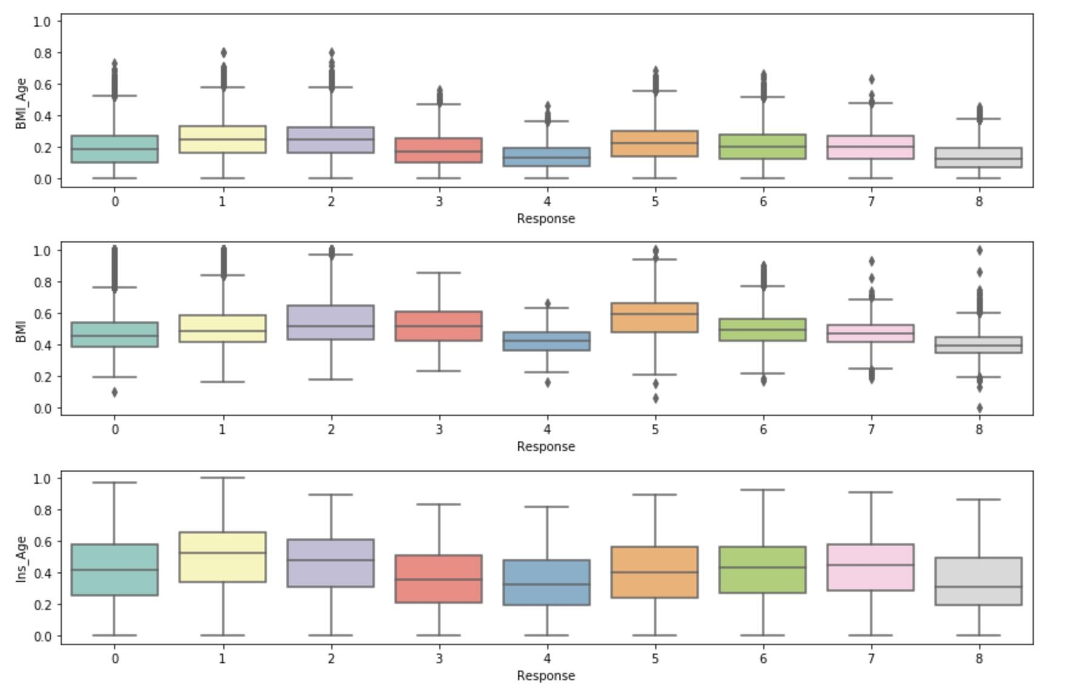
BMI_Age_Response
Notes:
We found in the process of exploring that if the two features are multiplied, the variance will be smaller. Thus, we combined BMI and Ins_Age.

Slide 14
Feature Selection: Random Forest
Feature | Importance
BMI | 0.087
Wt | 0.061
BMI_Age | 0.050
Product_Info_4 | 0.040
Ins_Age | 0.039
Employment_Info_1 | 0.036
Ht | 0.032
Medical_History_1 | 0.031
Medical_History_2 | 0.030
…... | …...
Notes:
用random forest进行fs
按倒序排列 看出部分特征的重要性如下
因为 特征太多 125个 我们猜测选取部分重要性高的特征训练可能会有更好的效果
所以我们尝试用前95%重要的特征作为接下来的训练集 进行训练

Slide 15
3.MODELING
Chenyu Xu (Erin)
Xiabing Hu (Mercury)
Notes:
Now, let me hand it over to Erin and she will introduce more details of the model for us.

Slide 16
59,381
44,536
14,845
Split Of Data Sets
Data Set
Train Set
75%
25%
Train Set
Test Set
Test Set
Notes:
First of all，we split the dataset to training set and testing set，taking the test_size of 0.25

Slide 17
Metrics
from ml_metrics
import quadratic_weighted_kappa
-1
<0.6
1
Notes:
For metrics, we use quadratic weighted kappa to measure the performance of the model. It calculates the similarity between our prediction and the actual values，ranging from minus one to one. The positive one means perfect match，while the negative one means totally not. Generally，point six is a relatively good result.

Slide 18
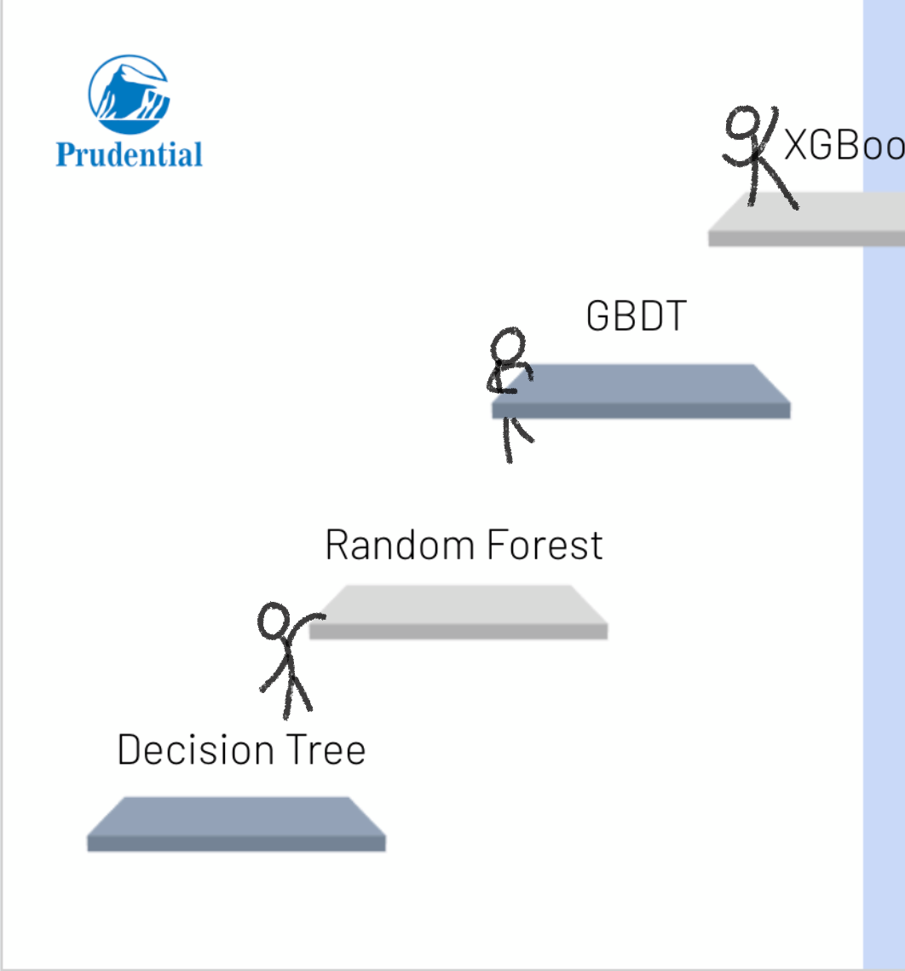




XGBoost
GBDT
Ridge Regression
Random Forest
Lasso Regression
Decision Tree
Linear Regression
Notes:
According to the characteristics of the problem, we preliminarily judge that the problem belongs to classification. Therefore, the tree model is considered. Decision tree, random forest, gradient boost decision tree and xgboost are used in turn, and gridsearch is used to help us find their respectively better parameter values. When adjusting the learning objective function of xgboost, it is found that linear regression can get the best results compared with other objectives. Therefore, we have tried to use linear, ridge, lasso regression to train, and found that their effect is not as good as xgboost. So we finally decided to use xgboost for learning.

Slide 19
 | Classification |  |  | Regression |  |  | XGB (Preprocessed) | XGB
 | DT | RF | GBDT | Linear | Lasso (alpha = 0.0009) | Ridge (alpha = 0.6)
Test Set | 0.44 | 0.47 | 0.43 | 0.50503 | 0.50039 | 0.50494 | 0.55 | 0.6
Train Set | 0.46 | 0.51 | 0.89 | 0.51672 | 0.5106 | 0.51644 | 0.62 | 0.67
Test Offset | 0.47 | 0.51 | 0.53 | 0.5647 | 0.56495 | 0.56458 | 0.61 | 0.66
Notes:
In the model evaluation, we put training set and testing set into the model to test their quadratic weighted kappa score and over-fitting degree. As can be seen from the graph, the quadratic weighted kappa score is gradually enhancing. It is found that GBDT has a high degree of over-fitting, and the cost of reducing over-fitting is the decrease of the metric score. What’s more, the three regression models can achieve the same effect of training. And the kappa score of testing set is higher than training set, which shows that the models are general to
Besides, after confirming the optimal position of xgboost, we tried other operations to enhance the accuracy. During the attemptation, we canceled some of the previous preprocessing operations, including restoring all dropped features, eliminating the use of random forest to filter features, eliminating scaling of data, and using - 10000 to impute all missing values. In fact, the results are better, so xgboost itself has a good adaptive ability.

Slide 20
XGBoost
Main Reasons for Good Performance
Regularization
Column subsampling
Automatically learning the missing value
Notes:
Here we list the final adjusted parameters of xgboost model.
There are three main reasons why XGB has such a good performance:
(1) XGB chooses to use L1 or L2 regularization to get lower variance, thus avoiding over-fitting to some extent;
(2) XGB reduces over-fitting by column subsampling, and improves the speed of training, making the process of adjusting parameters more convenient;
(3) In dealing with missing values, for samples with missing values, xgboost can automatically learn its splitting direction.

Slide 21
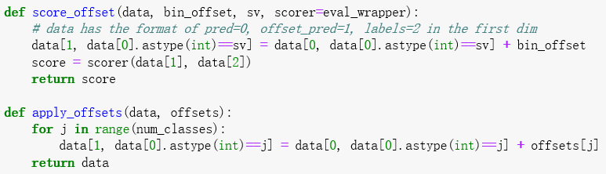
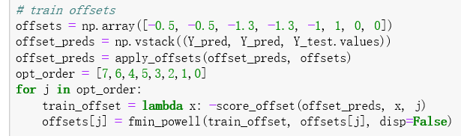
Offsets
For each classification j (1~8)
Find optimal offset value
To Min f(x) ⇔ Max score =
Preds+ offset
Actual

Slide 22
XGBoost -- The Best Result
objective = “reg:linear”
eta = 0.03
min_child_weight = 190
subsample = 0.9
colsample_bytree = 0.3
silent = 1
max_depth = 7
Quadratic Weighted Kappa
0.65854

Slide 23
4.INTERPRETATION OF RESULTS
Xiabing Hu (Mercury)

Slide 24
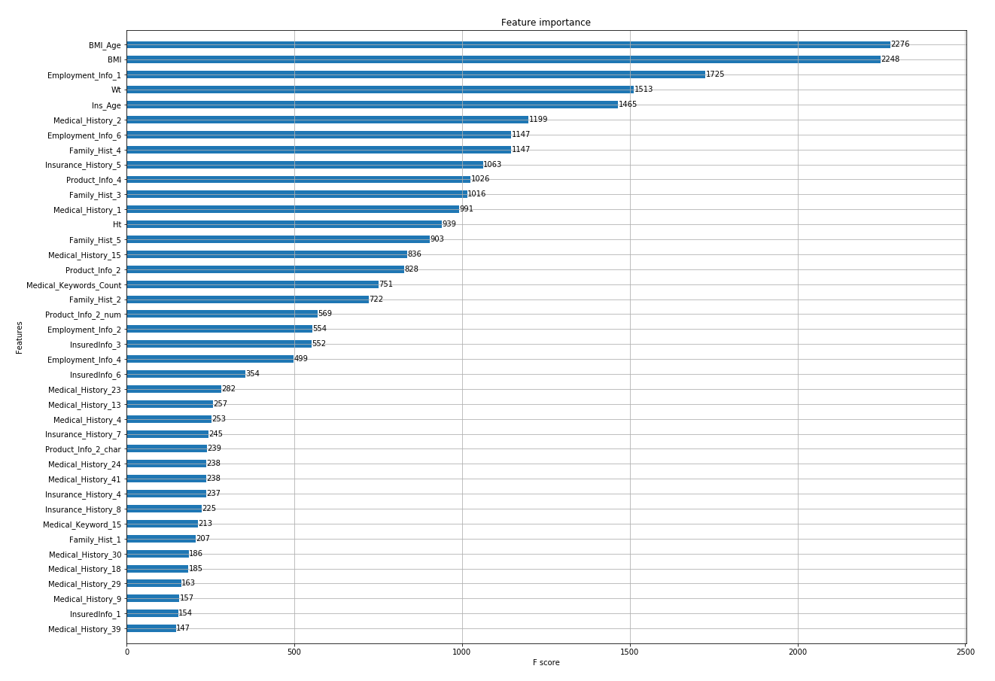
Feature Importance
Type: weight
BMI_Age
BMI
Employment_Info_1
Wt
Ins_Age

Slide 25
5. IMPROVEMENT
Zhaoning Qi (Jeff)

Slide 26
Improvement
Function to optimize boundary
Feature selection
Fill NaN for regressors

Slide 27
6.BUSINESS IMPACT
Zhaoning Qi (Jeff)

Slide 28
Business Impact
Efficiency in processing applications
Reducing risks
Facilitate the pricing process

Slide 29
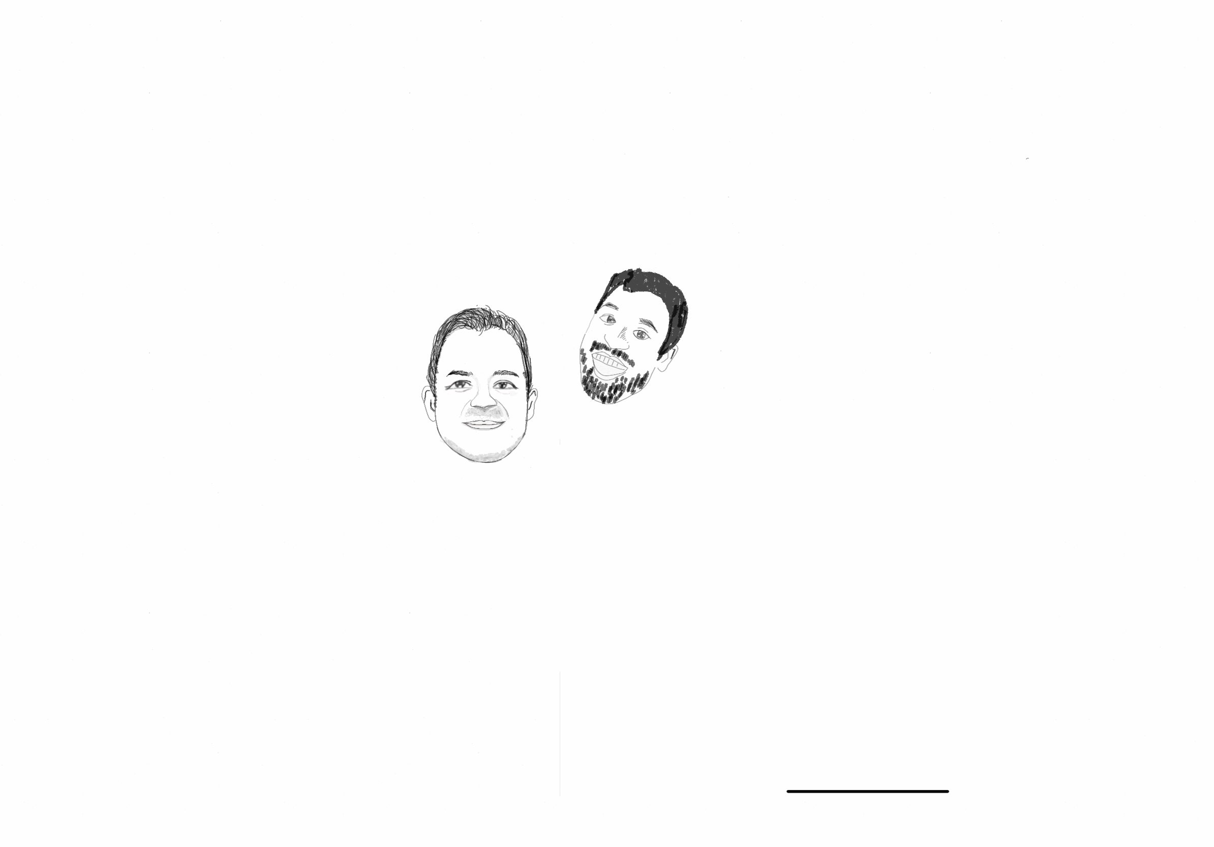
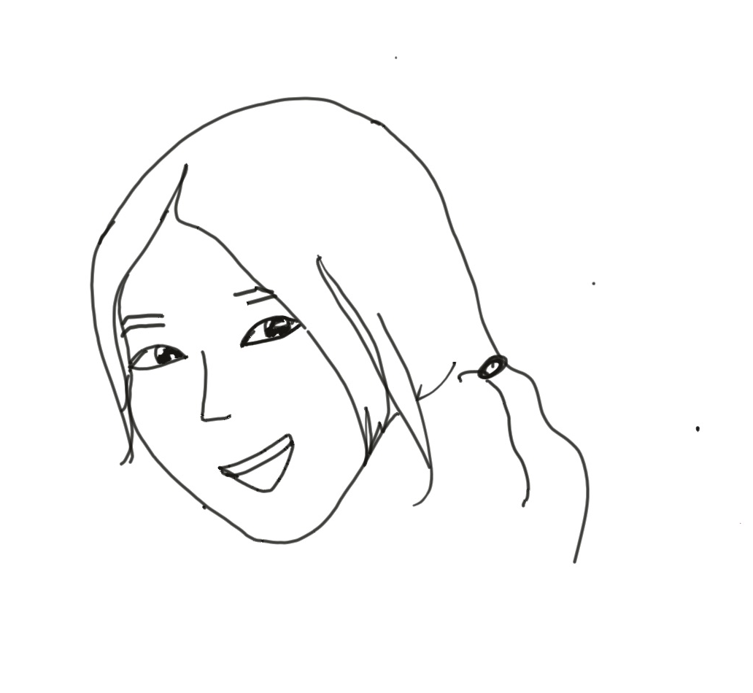
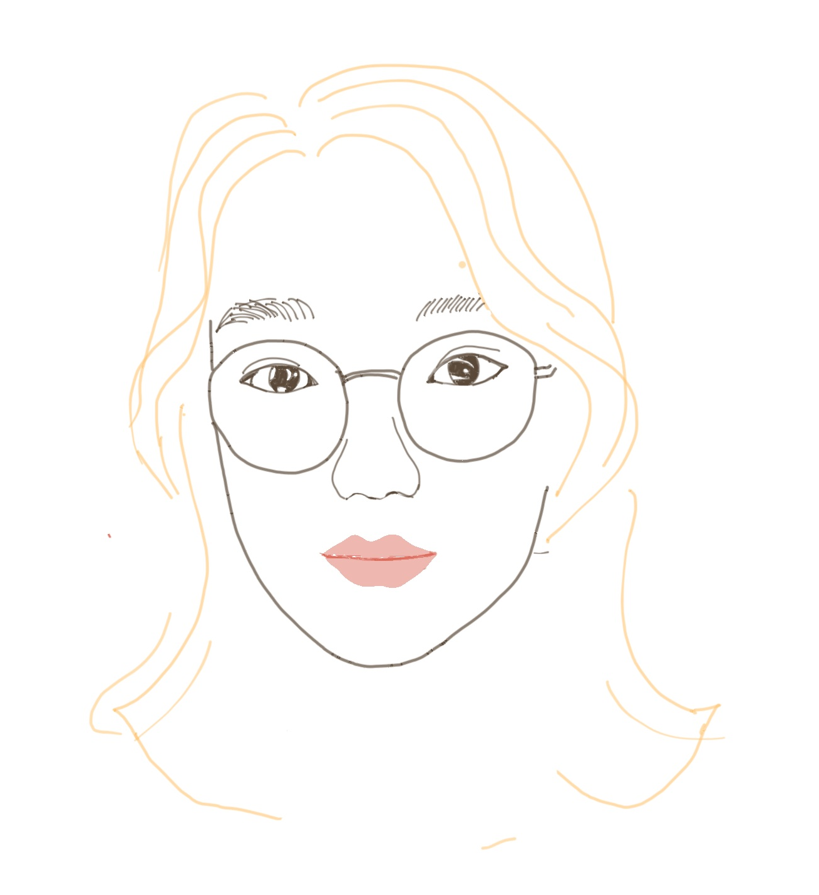
Credits
Special thanks to Professor Miquel Noguer i Alonso, Mr Gilberto Batres-Estrada, Chris Fu and Cara Wang and to all the people who helped us to complete the project during this three weeks.
Notes:
Last but not least, we would like to say thank you to our professor Miquel, to our mentor Gilberto, to our TA Chris, to our counselor Cara and to all the people who have helped us during this three weeks. Thank you very much! And also, we want to thank ourselves, cuz I think that today's achievement is due to our unremitting efforts

Slide 30
THANKS!
Any questions?

